Slide 1

Autonomous Intersection Management (AIM)
By: Team Trier Charles Arsenal Okere(Charles) Muhammad Amirul Hakimi bin Zaprunnizam(Amirul) Muhammad Iqbal bin Mohd Fauzi(Iqbal) Muhammad Farid Izwan bin Mohamad Shabri(Farid) Muhammad Amjad bin Abdul Malik (Amjad)

Slide 2
Problem?
Car crashes at intersection point or junction without traffic controls.
Time wasted
Emission
Heavy Traffic

Slide 3
Solution
V2V Protocol = Share datas between one vehicle to another for example speeds,
Total Bandwidth Server Algorithm = Scheduling aperiodic task
Vehicle Collision Warning Communication Protocol
Management Centre/Server Hub to send information
Fcfs

Slide 4
Design
Activity Diagram
State Machine Diagram
Sequence Diagram
Use |Case Diagram

Slide 5
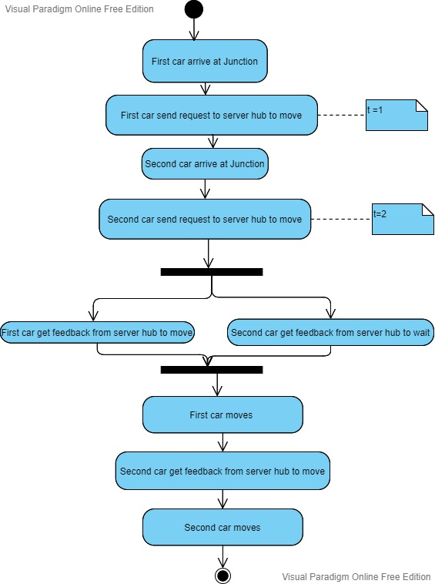
Activity Diagram for car scenario

Slide 6
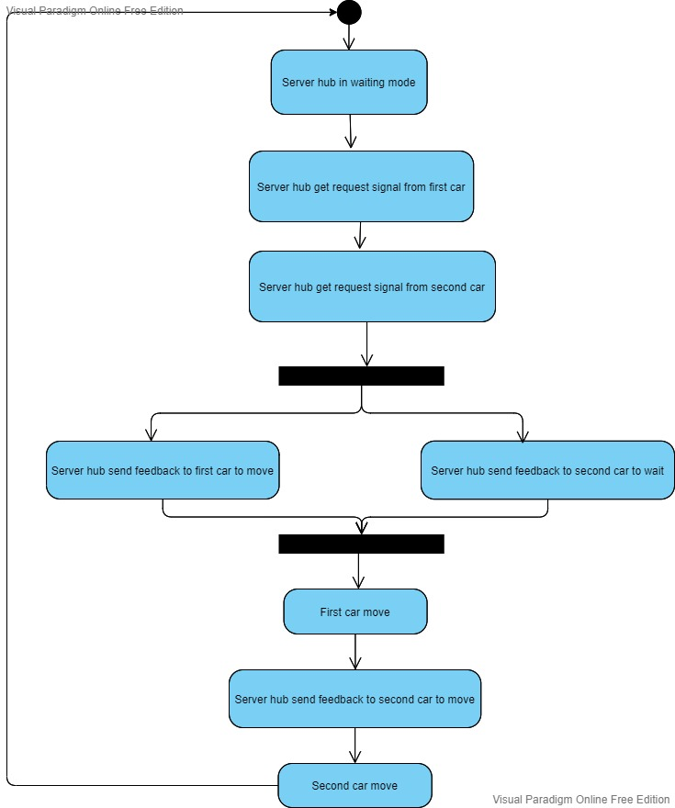
Activity Diagram for server hub

Slide 7
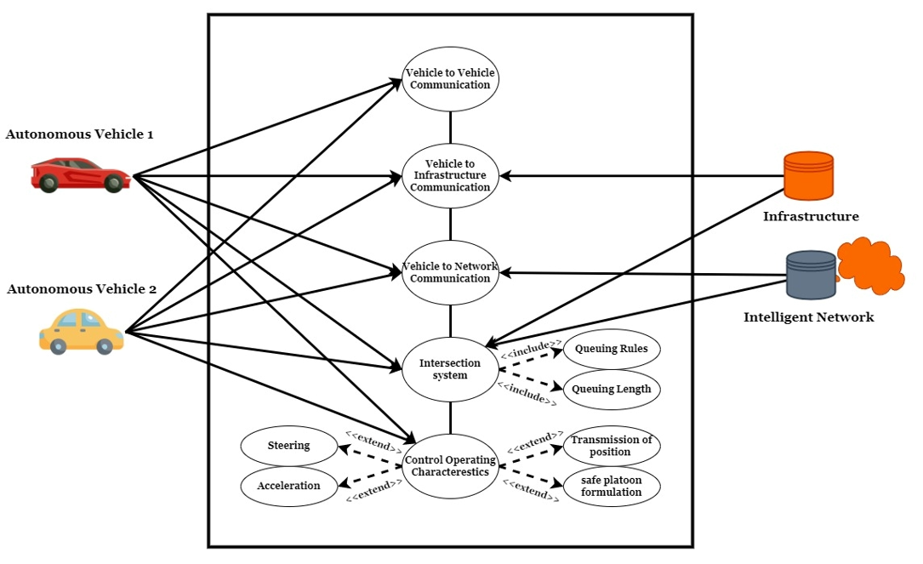
Use Case Diagram

Slide 8
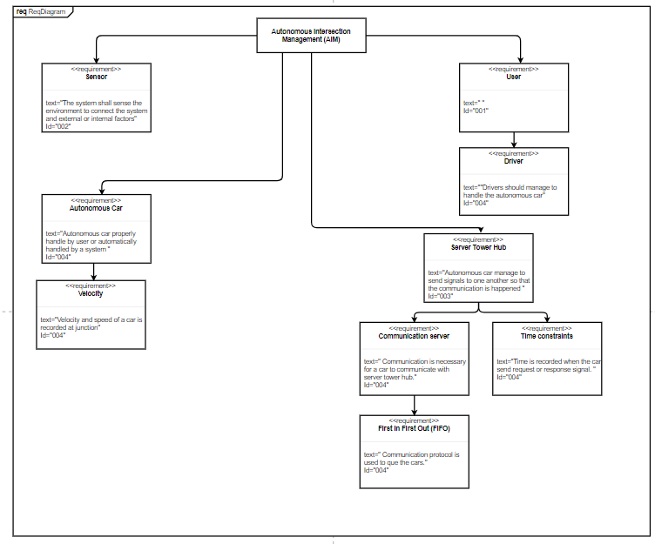
Requirement Diagram

Slide 9
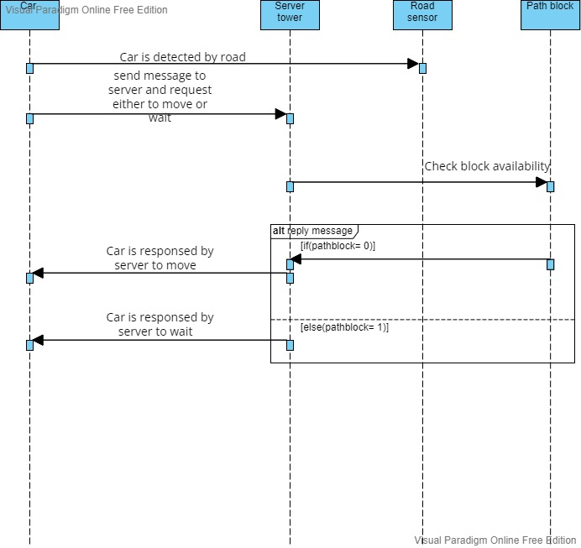
Sequence Diagram

Slide 10
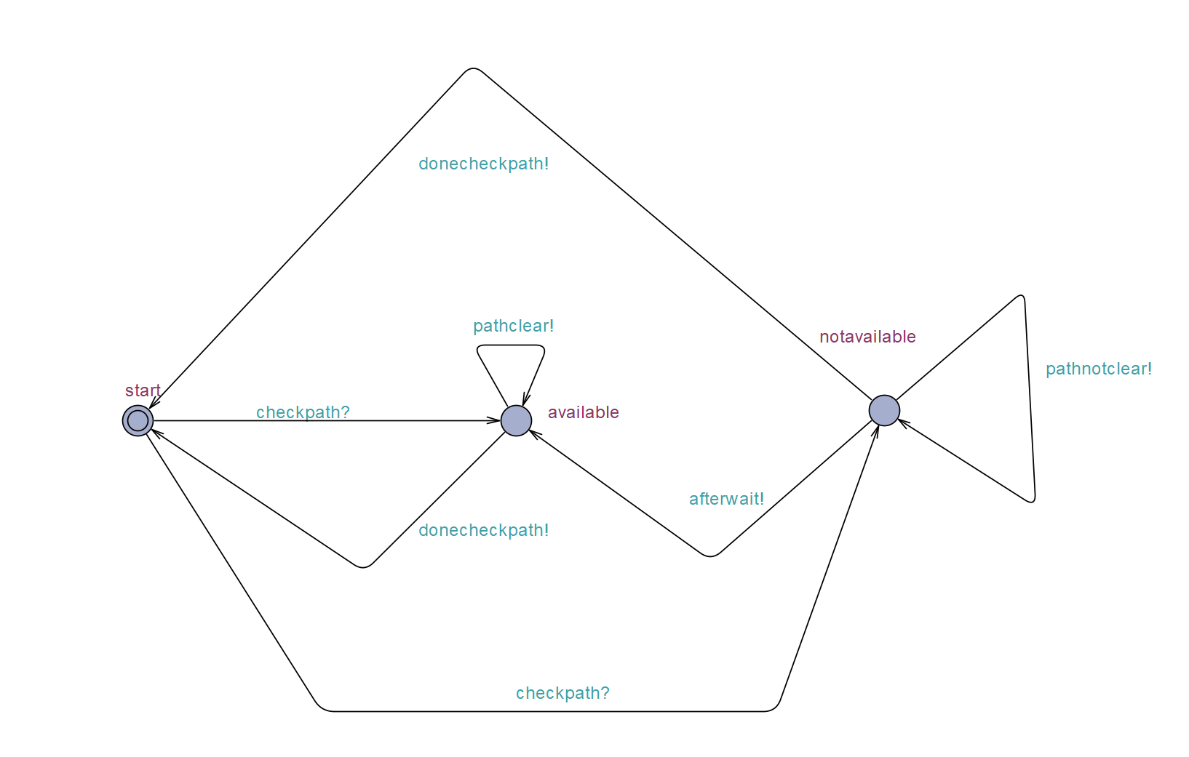
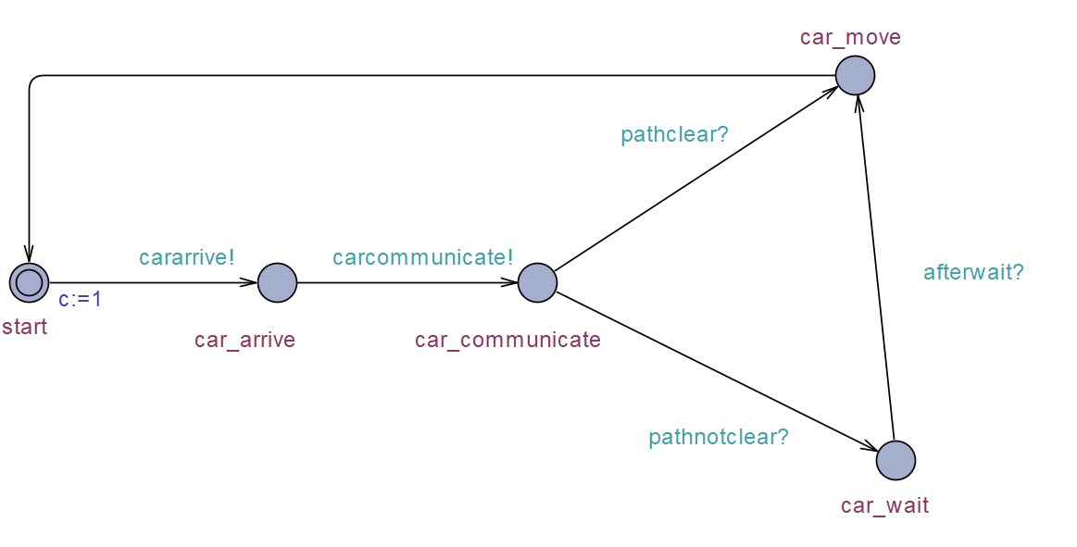
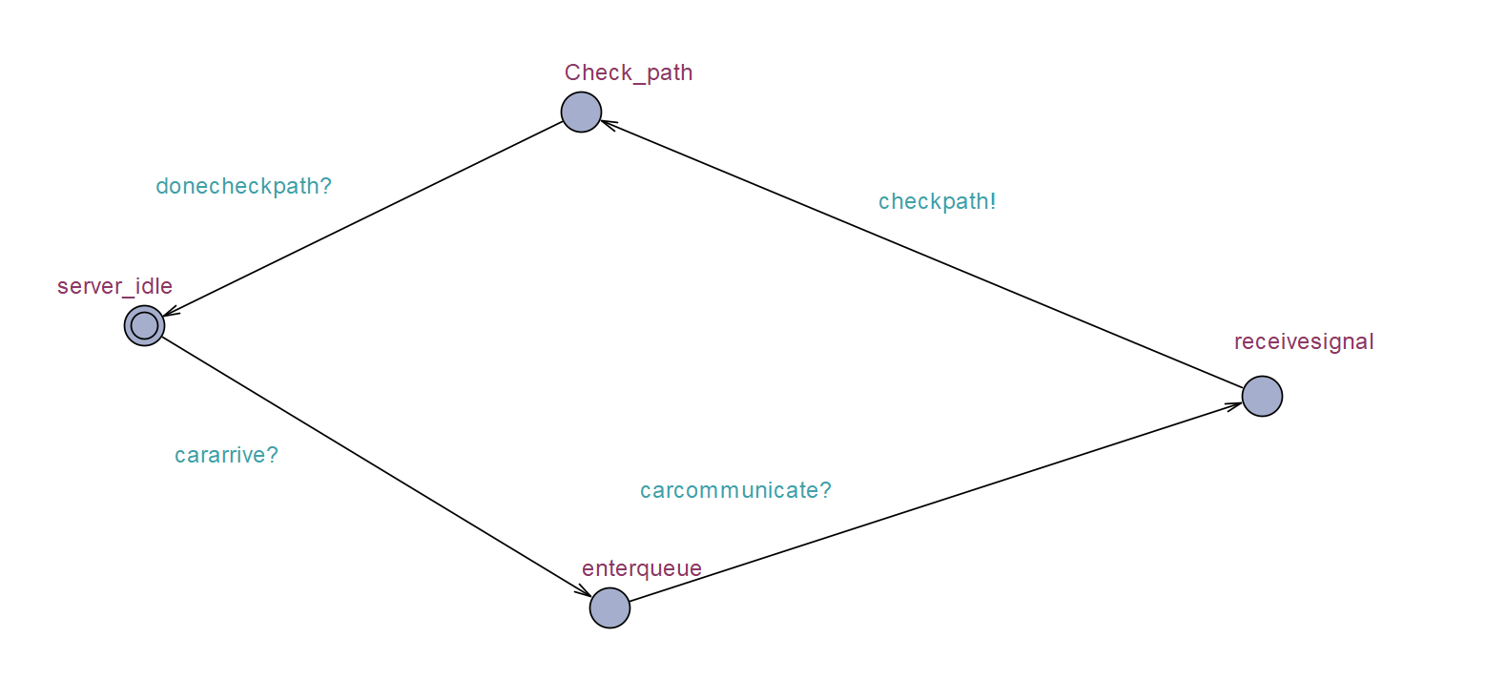
UPPAAL
Car State
Server State
Path State

Slide 11
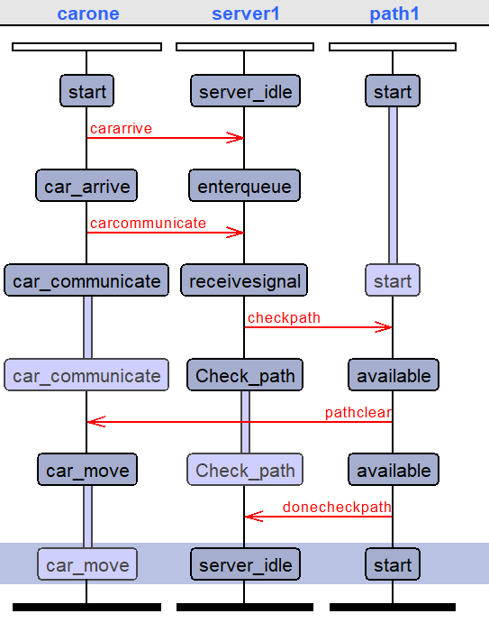
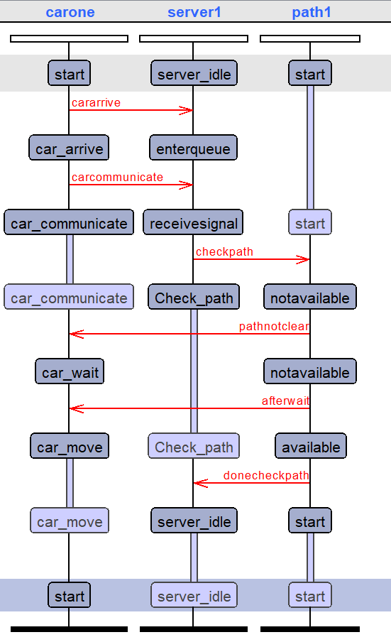
Simulation

Slide 12

Implementation

Slide 13
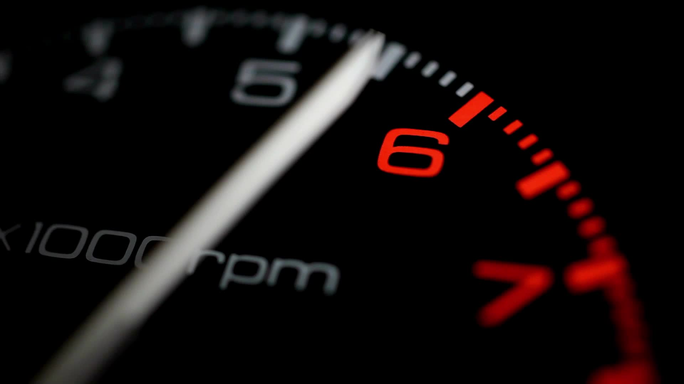
Real Time Operating System(RTOS)

Slide 14
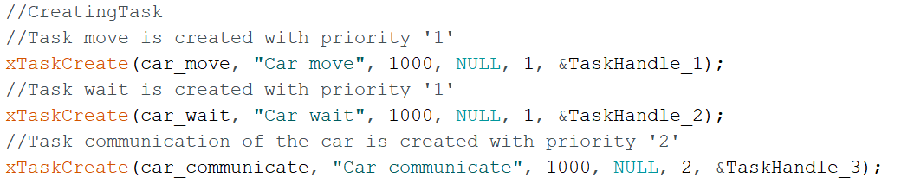
Create Task
car_communicate = priority “2”
car_wait = car_move = priority “1”
Priority 2 > Priority 1

Slide 15
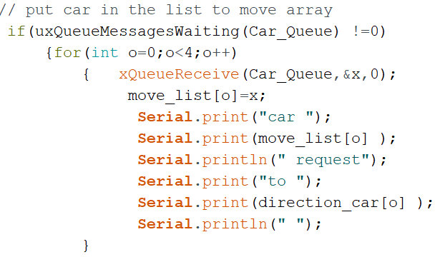
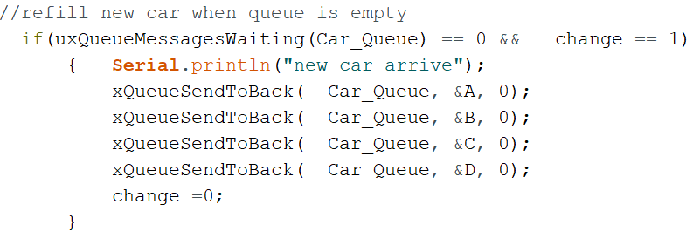
Queue Management
Task Communication

Slide 16
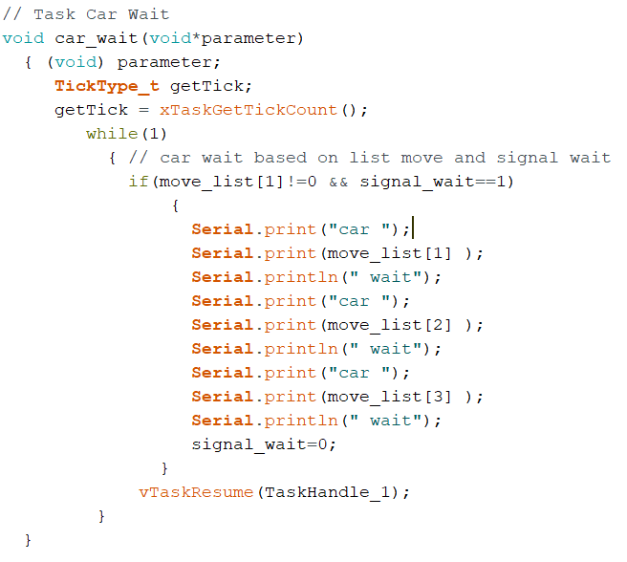
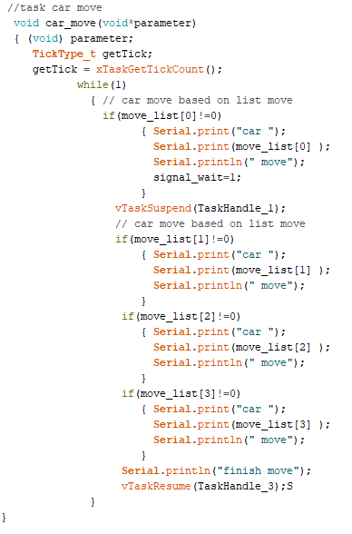
Concurrency

Slide 17
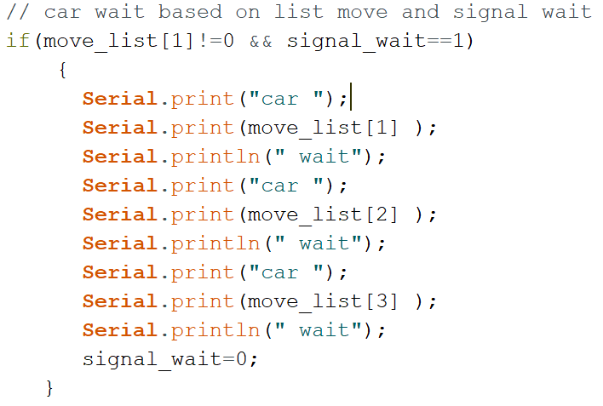
Wait Management
Car Wait Task

Slide 18
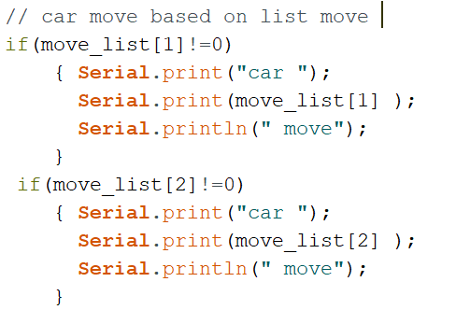
Moving Management
Car Move Task

Slide 19
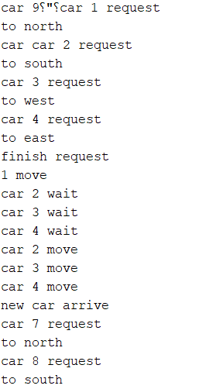
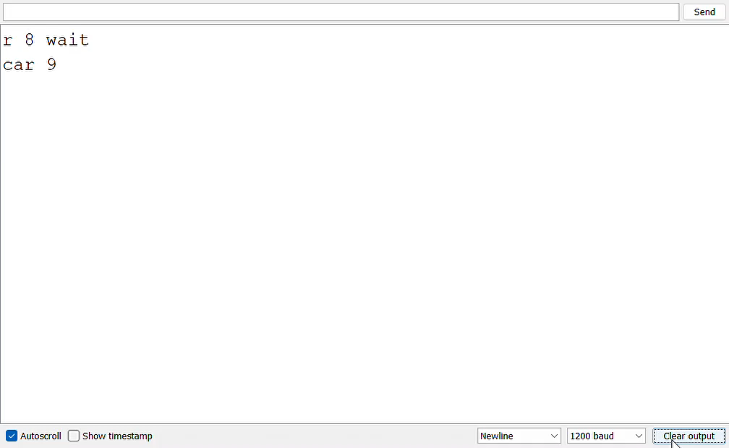
Result

Slide 20

VHDL

Slide 21
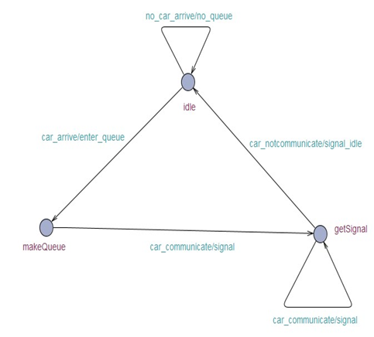
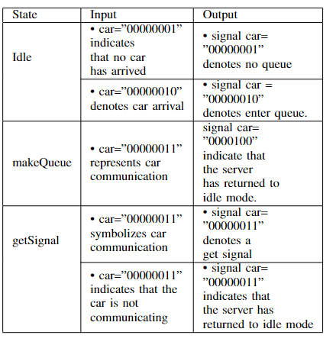
Finite State Machine (FSM)
Communication between car and server
Three state :Idle, makeQueue,getSignal

Slide 22
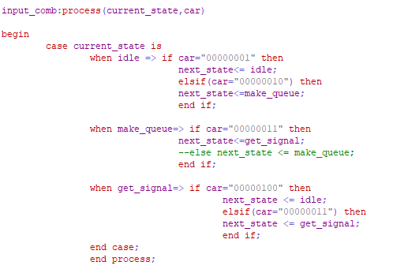
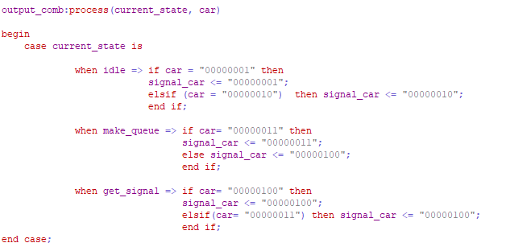
Input and Output

Slide 23
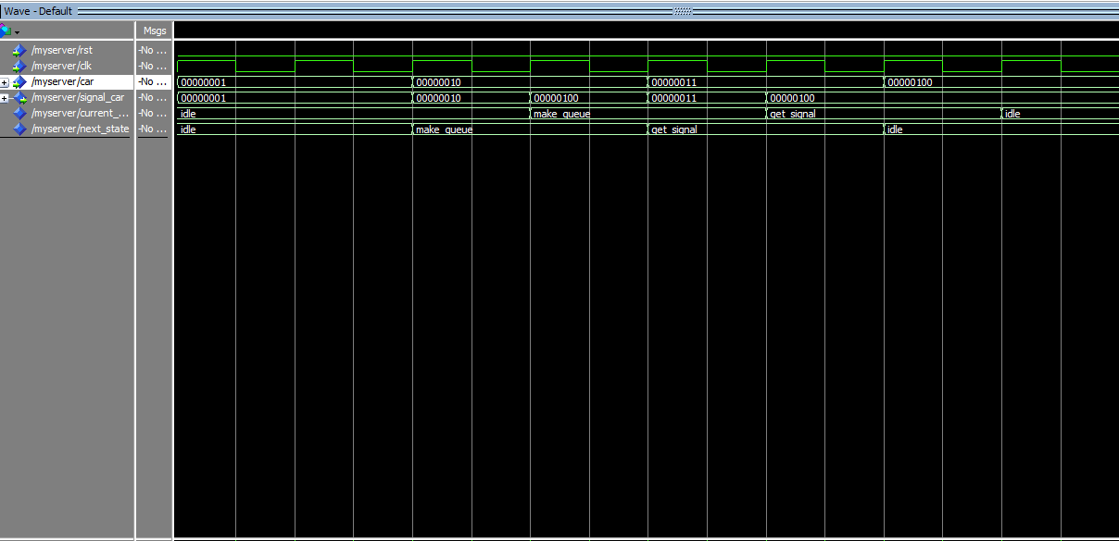
Result

Slide 24

Thank you

